Slide 1
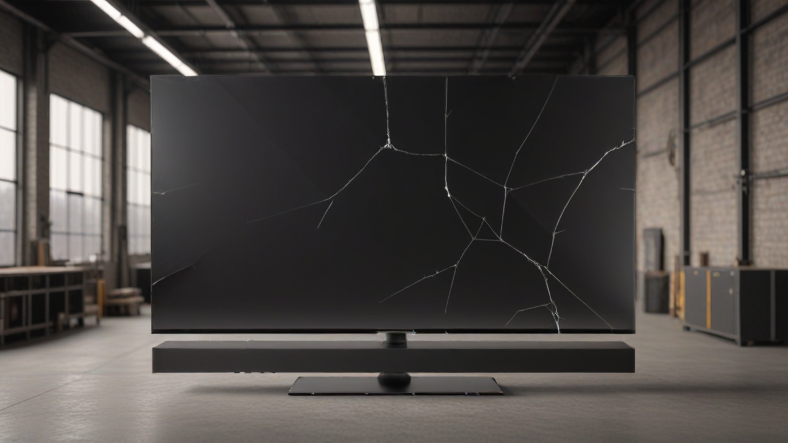

Project Review: AI for Defect Detection
The Problem
The Solution
Novelty
Obtaining real broken TV screen data is expensive, rare, and difficult.
Generative AI (Inpainting) creates synthetic, high-quality datasets for QA models.
Using synthetic data to ensure the final product is without any flaw.
Changes from Proposal: Due to inconsistent generation quality with small masks,
we shifted to using Full-Screen Masks.
Since the generated defects now characterize the entire screen rather than a specific isolated point, the task logically shifted from Object Detection, classification to only Image Classification

Slide 2
Related Work & Project Context
Title / Year
Task
Methods
Data
Results
Relation to Project
Latent Diffusion for Defect Segmentation (2024)
Surface Defect Segmentation
Stable Diffusion for Data Augmentation (Synthetic Generation)
NEU-DET (Steel Surfaces)
Improved Mean IoU (mIoU) by 6.85% compared to baseline models
Provides empirical evidence that Stable Diffusion specifically improves defect detection accuracy in industrial tasks.
DefectFill (2025)
Realistic Defect Generation
Inpainting Diffusion Model to inject defects into healthy samples
MVTec AD (anomaly detection dataset)
Validated that inpainted synthetic defects significantly improve detection model performance
Direct validation: Uses the exact same logic as our project—taking a clean product and "inpainting" a defect to solve data scarcity.
YOLOv11 Benchmark (2025)
Real-time Object Detection
Comparative study of YOLOv5, v8, and v11
Solar Panel Defect Dataset
YOLOv11 achieved 93.4% mAP
Justifies our choice of classification model.
Notes:
Mean IoU (Intersection over Union): A metric that measures how accurately the model’s predicted “mask” overlaps with the actual object.

Slide 3
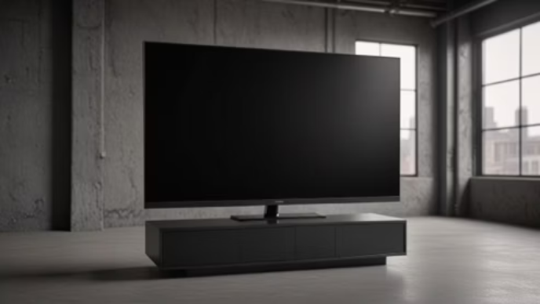

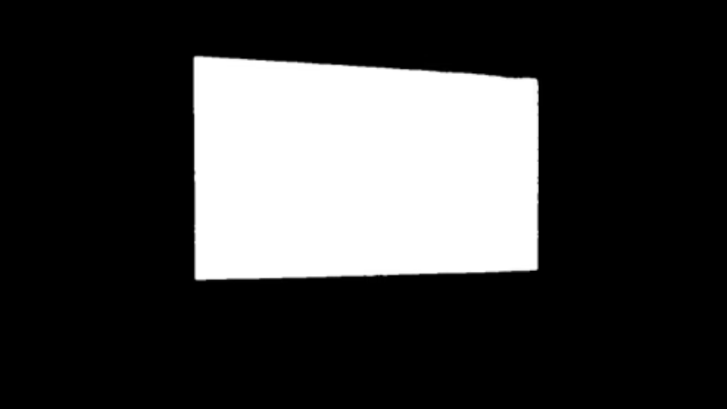

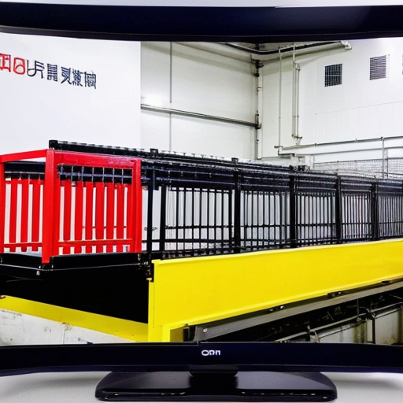
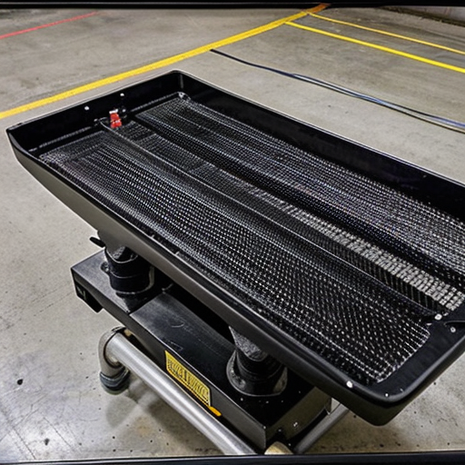
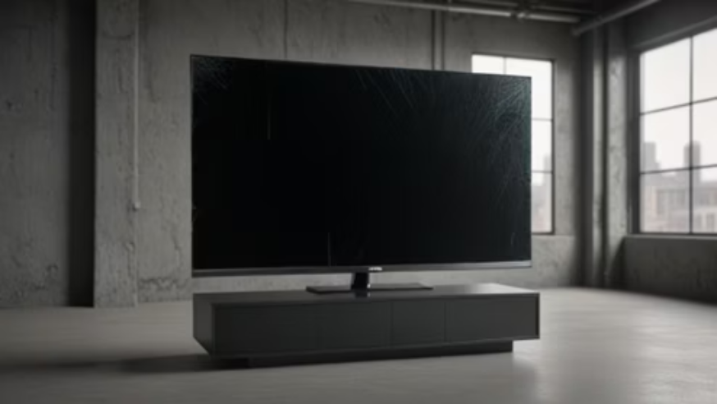

Dataset & Generation Pipeline
Class Distribution
4 distinct classes generated cyclically for balance:
Base Generation
Spiderweb (cracks)
SDXL Lightning (RealVisXL V4.0) for realistic TV pictures.
Scratch (surface damage)
Shattered_corner (structural damage)
Puncture (impact holes)
We iterated through four model versions and plenty of trial and error to transform these early attempts into the final, high-quality results.
Smart Labeling & Masking
OWLv2, SAM for binary masks of the screen.
Defect Injection
SDXL Inpainting to inject specific defects into masked areas.

Slide 4
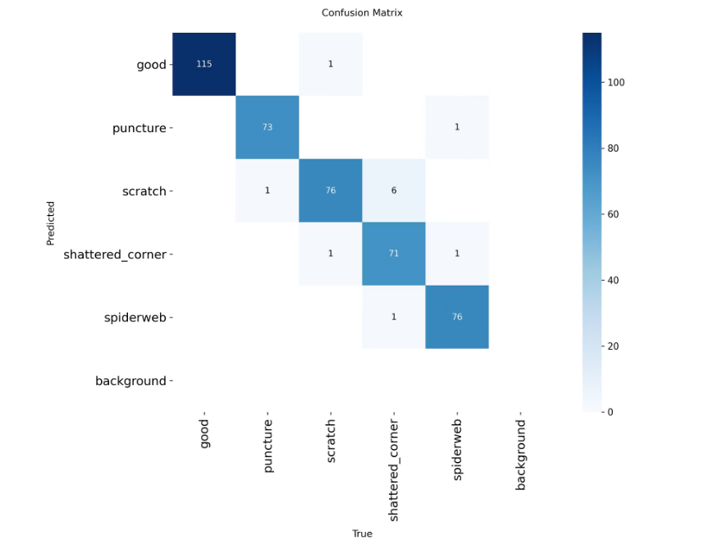
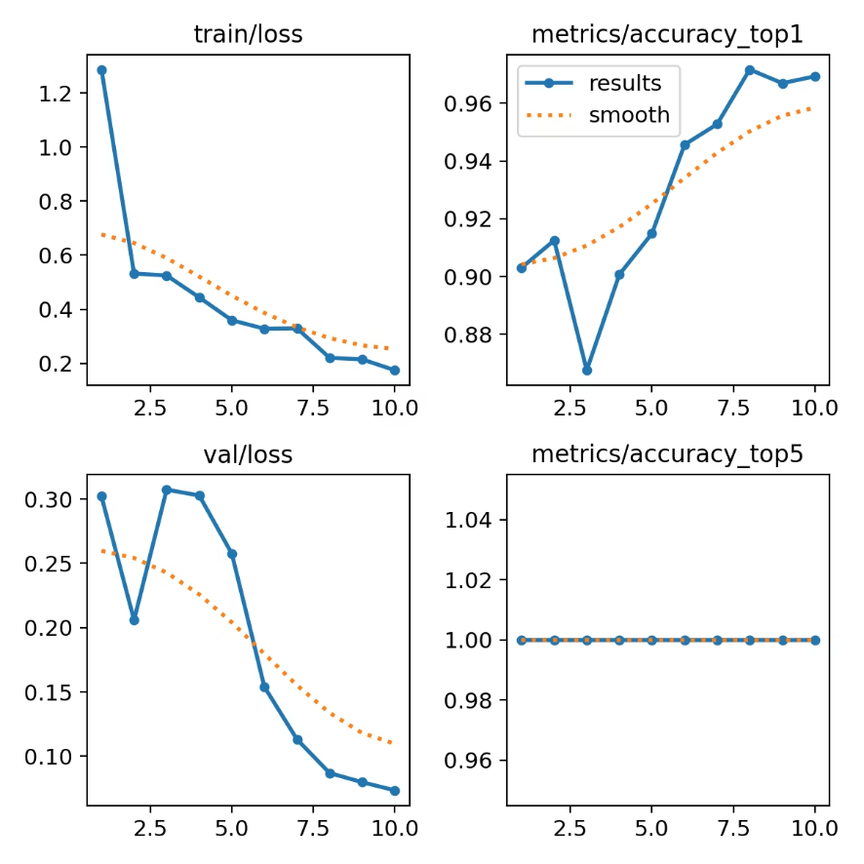
Training Results
Model Architecture: yolo11n-cls chosen for its speed and efficiency in image classification tasks.
Training Setup:
Epochs: 10
Image Size: 640x640
Split: 80% Train, 20% Validation.
Recall of 0.966 and accuracy of 0.971

Slide 5
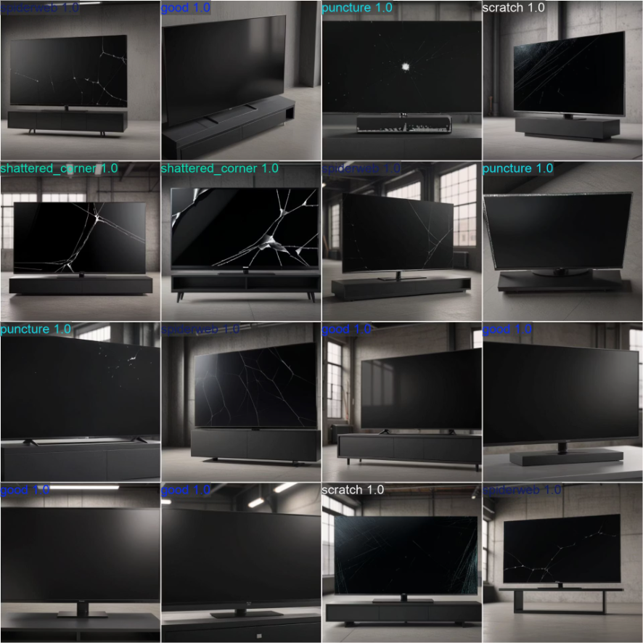

Slide 6
Project Plan & Technical Scope
Project Step | Technical Scope & Models Used | Expected Outcomes | Due Date
Pipeline Optimization: Masking & Realism | Mask Refinement: Fine-tuning the segmentation model to exclude TV stands to prevent inpainting artifacts. Inpainting Tuning: Adjusting generative parameters (Prompts, Strength, Guidance Scale) to ensure defects are realistic and clearly visible in all generated outputs. | An optimized pipeline producing accurate masks and realistic defects. | [hopefully before the final presentation]
Mass Dataset Generation | Batch Processing: Executing the optimized pipeline on a large scale. Data Augmentation: Utilizing varied prompts and random seeds to create a diverse range of defects and visual conditions for training data. | A large-scale, diverse synthetic dataset ready for model training. | [31/12/25]
Sim-to-Real Validation | Model Training: Training a detection model on the full generated synthetic dataset. Inference Testing: Testing the trained model on a separate set of real defective TV images to evaluate capabilities. | Validation metrics determining if the model can successfully detect real-world defects based on synthetic learning. | [hopefully before the final presentation]
Prepare Final Presentation | Aggregating results, visualizing "Synthetic vs. Real" comparisons, and summarizing the technical challenges and model performance. | Final presentation | [hopefully before the final presentation]

